Slide 1
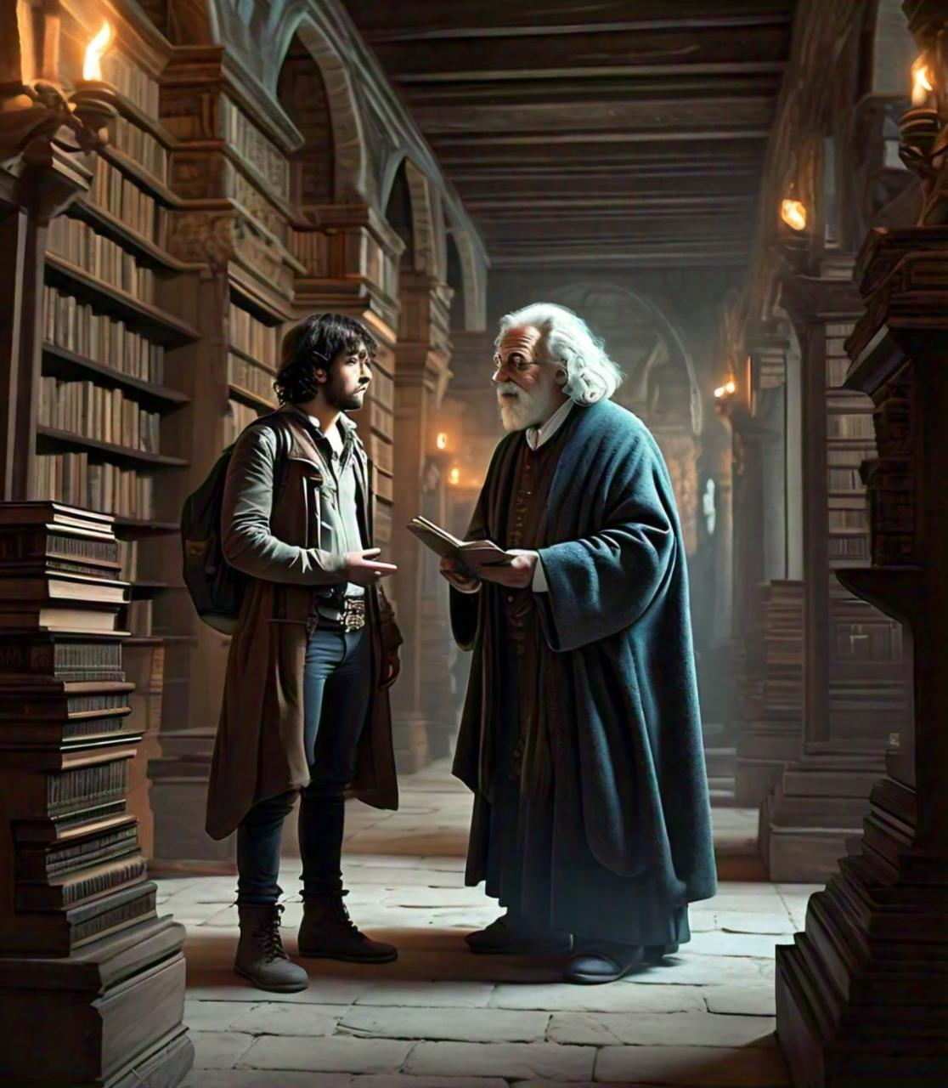
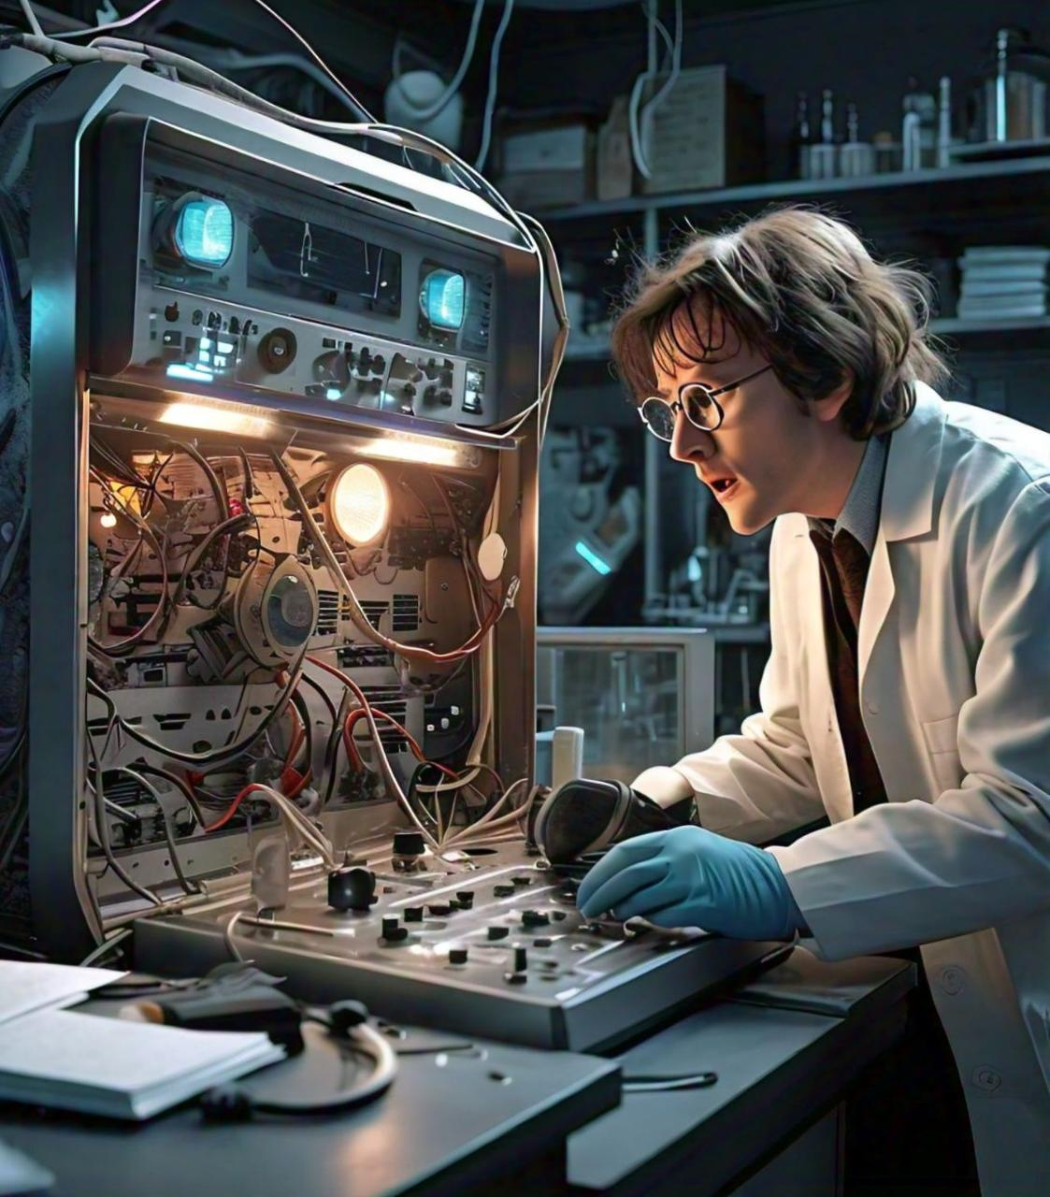
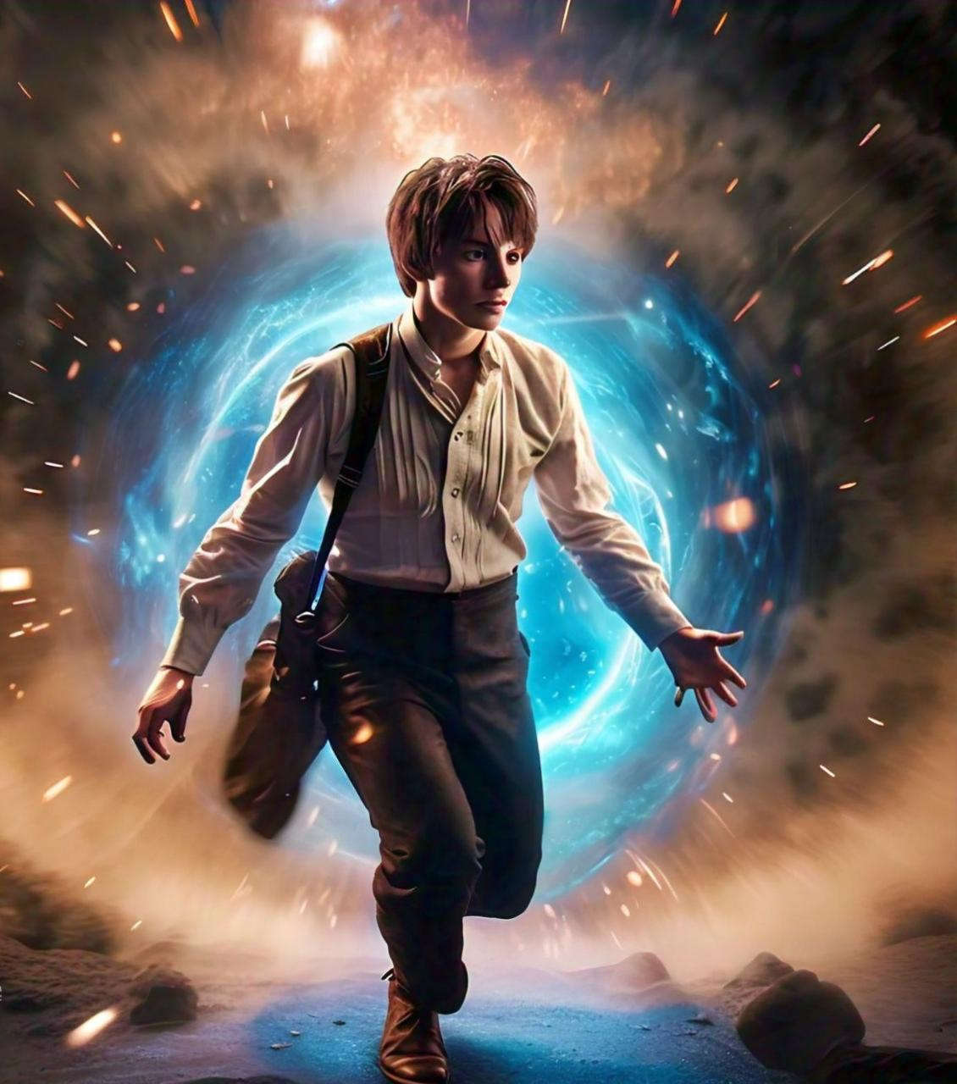
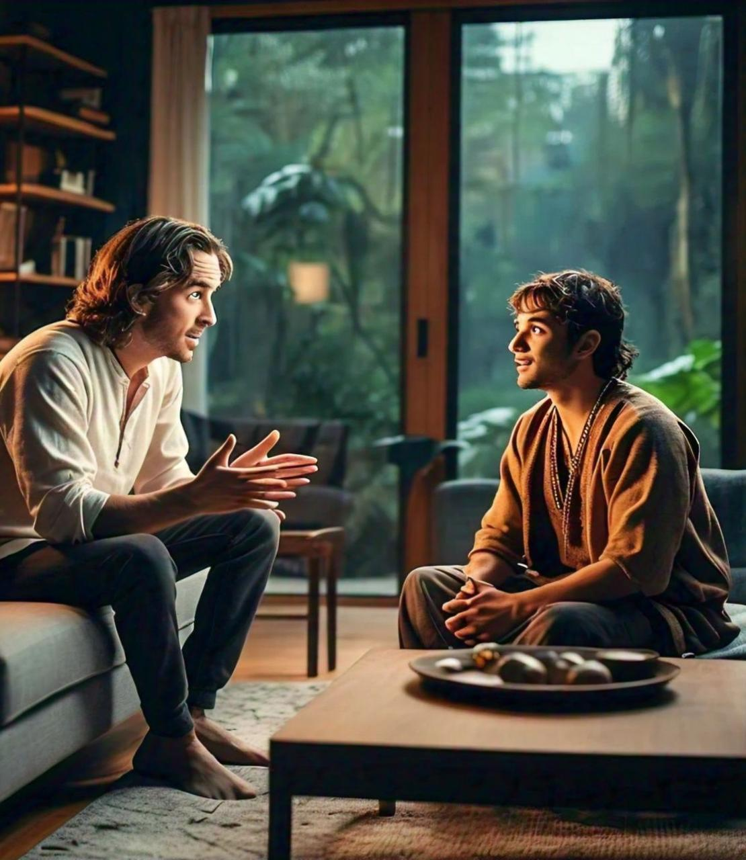
A TIME TRAVELLER
Scene 2 : that person passed through the time travelling
Scene 4:
The person returning to the present and sharing their experiegnce
Scene 1:
A person accidentally activating a time machine.
Scene 3: person traveling to the past and meeting a historical figure.

